Slide 1
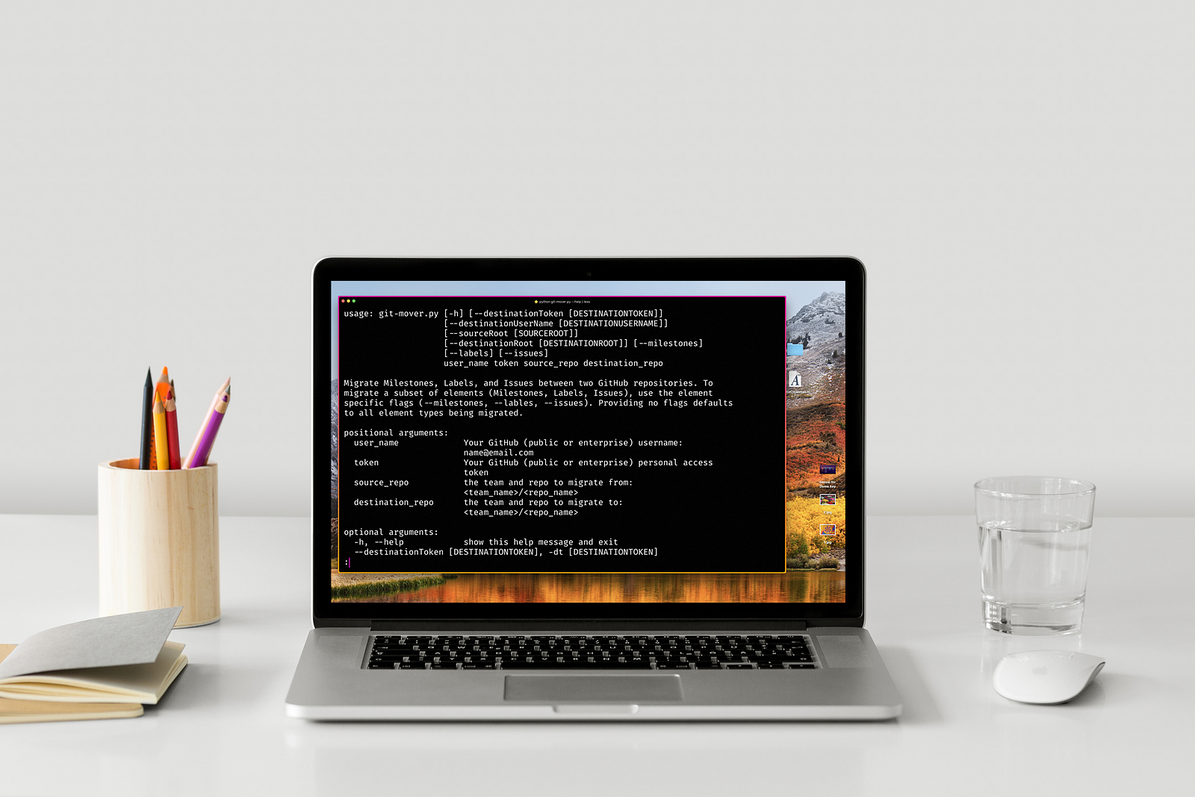

INTRODUCTION TO GITHUB
This P by Unknown Author is licened under CC BY-NC
AUTHOR : SYEDA FIZA FATIMA RIZVI
DEPARTMENT :
BSCS
BACIS INFORMATION
This Photo by Unknown Author is licensed under CC BY-SA-NC

Slide 2
WHAT IS GITHUB?
Git hub is a website that allows a developer to store and manage their code using git .
https//github.com
PURPOSE:
It has a wide use all over the world for developers .

Slide 3
KEY FEATURES OF GITHUB :
Repositories : store and organize project files .
Version control : track changes to code over time.
Collaboration : multiple users can work on same project.
Pull requests: propose changes to a project for a review .
Issues : track bugs ,task and feature request .

Slide 4
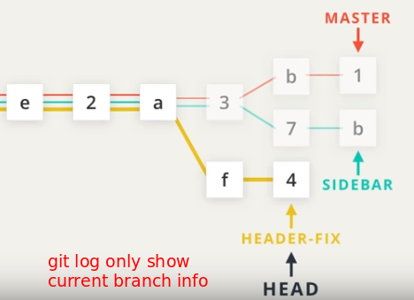
GIT VS GITHUB :
GIT :
A VERSION control system to track code changes .
GITHUB:
Its is a platform that hosts git repo and provides collaboration tools .
Visuals :
Diagrams showing git and git hub relationship.
This Photo by Unknown Author is licensed under CC BY-NC

Slide 5
Creating a repository :
Sign in to github.
Click on “ new repository” .
Set repo name and visibility (public/private )
Initialize with a README (optional).
Create the repository .
Its mean like a folder where all files related to project are stored. .
This Photo by Unknown Author is licensed under CC BY-SA-NC
This Photo by Unknown Author is licensed under CC BY-SA

Slide 6
HOW GITHUB TRACK CHANGES :
It track changes using git (version control changes ).
Snapshot
History
Branches
Collaboration

Slide 7
HOW GITHUB COMMIT CHANGES :
It means saving your changes to project history .When you commit ,you are telling git to record work you have done since last commit .
Make changes
Stage the changes
Commit changes
Write a message

Slide 8
GITHUB DESKTOP APPLICATION :
IT is a graphical user interface(GUI) that allows you to interact with git hub repo without using command line .
Its provides a simpler way for developers especially beginners to manage their git hub repos and perform common git task.
For example :
Cloning ,commiting ,pushing and pulling code .
Why we use desktop application?
It is a friendly use
Easy to access
Visual interface

Slide 9
INTRODUCTION TO :
CYGWIN
MINGW
ITS Is a complete linux like environment .
With Cygwin ,programs can run on windows if they are running on linux system.
It requires a special Cygwin DLL ,means that will still depend on Cygwin environment to work which may affect performance .
It stand for “ minimalist GNU for windows “.
It compiles window programs without linux emulation.
Provide set of tools that allow you to compile native windows application using GCC.
Don’t need any special environment to run a window .

